Slide 1
Aerotech LabVIEW
Interface
What, Why, and How

Slide 2
Your Mission
After today, you should be able to:
Explain how the Aerotech LabVIEW VIs are organized
Debug and troubleshoot LabVIEW VIs
Create a new LabVIEW project that used the Aerotech VIs
Create a simple VI

Slide 3
What You Will Learn
WHY you want to use LabVIEW
Information about ORDERING Aerotech LabVIEW VIs
How to USE the Aerotech LabVIEW VIs
  How to use the Samples project
  How to reuse the VIs in another project, including keeping the files in the project synchronized with the installed version of Aerotech software
  How to debug and troubleshoot a VI
  How to create a simple VI

Slide 4
Why
You Want to Use it

Slide 5
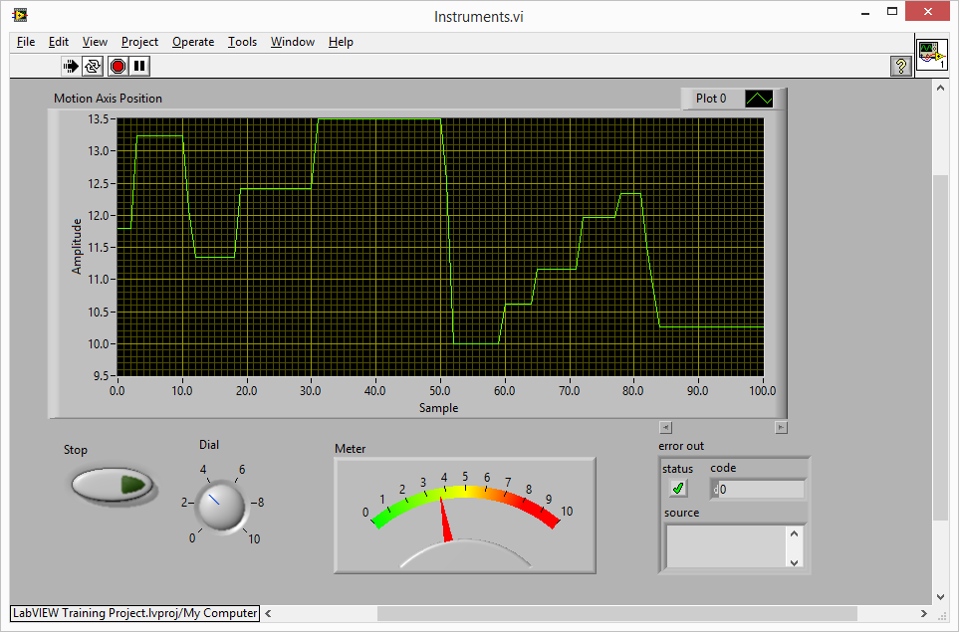
Why Use LabVIEW?
LabVIEW is a graphical programming environment
created by National Instruments (NI).

Slide 6
Why Use LabVIEW?
LabVIEW is useful for creating applications that interface to multiple components in a system (e.g., data acquisition, measurement, motion control, communications).
Many university and R&D centers program in LabVIEW. Users that know and use LabVIEW want to program in LabVIEW.
Resources
  http://www.ni.com/labview/
  http://www.ni.com/labview/why/
  http://www.ni.com/getting-started/labview-basics/

Slide 7
Why Use Aerotech LabVIEW VIs?
Any company can create a library of LabVIEW Virtual Instruments (VIs). Customers can use LabVIEW to combine Aerotech VIs and VIs for other instruments in their system.
The Aerotech VIs use the .NET Library so the user
doesn’t have to. LabVIEW users only need to use the Aerotech VIs.
Aerotech offers LabVIEW VIs for each motion controller.

Slide 8
Information About
Ordering
Aerotech LabVIEW VIs

Slide 9

Version Information
Installed only with a license key that includes the LabVIEW option.
There is a LabVIEW option for the A3200, Ensemble,
and Soloist software.
In A3200 3.00, the LabVIEW offering was remodeled.
You cannot use the 2.5x LabVIEW VIs in A3200 3.00 or above.

Slide 10
Supported Versions of LabVIEW
The controller software supports these versions of LabVIEW.
2015 (32-bit and 64-bit)
2014 (32-bit and 64-bit)
2013 (32-bit and 64-bit)
2012 (32-bit and 64-bit)
2011 (32-bit and 64-bit)
2010 (32-bit and 64-bit)

Slide 11
How to
Use
Aerotech LabVIEW VIs

Slide 12
Overview
General stuff you
need to know

Slide 13
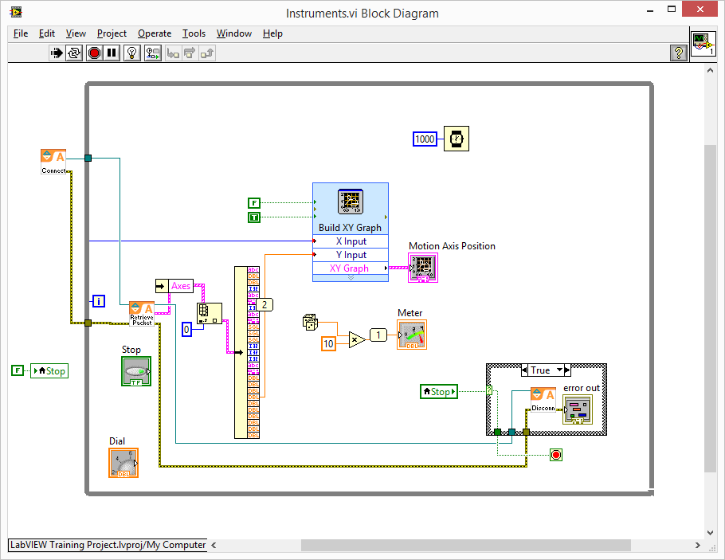
Overview
LabVIEW Virtual Instruments (VIs) are installed by the controller software. They are in the installation folder: [Installation Folder]\LabVIEW\2010
Every VI has:
Front Panel
for the user interface
Block Diagram
to code the functionality of the VI

Slide 14
Overview (continued)
LabVIEW VIs use objects in the .NET Library.
National Instruments strongly recommends that VIs that use .NET objects be contained in a LabVIEW project and not be used as standalone VIs.
For more information, refer to the
National Instruments LabVIEW help topic:
Using .NET with LabVIEW

Slide 15
Overview (continued)
Most Aerotech VIs are designed to be used as
sub-VIs — components to construct higher level VIs.
For example, you can open the Front Panel and run Connect.vi to connect to a controller. But, the purpose of the VI is to be used within another VI’s Block Diagram (e.g., another VI that will connect, enable, move an axis, check status, disconnect).

Slide 16
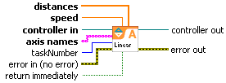
Overview (continued)
LabVIEW has context help that shows how to wire inputs and outputs.
The controller help file has an image and description of the input and output terminals.

Slide 17
Overview (continued)
Some Aerotech VIs are polymorphic VIs which can accommodate different data types for an input terminal.
For example, Enable.vi can do either of the following:
  Accept a string for an axis name and enable only one axis. The corresponding VI is also in the project: EnableSingle.vi
  Accept an array of strings for axis name and enable each axis. The corresponding VI is also in the project: EnableMultiple.vi

Slide 18
Samples Project
Overview
Samples Project folders
  Initialize
  Motion
  Utility
  Status
  Commands
  Parameters
  Scope
  File (standalone only)
  Examples
Debugging and troubleshooting VIs

Slide 19
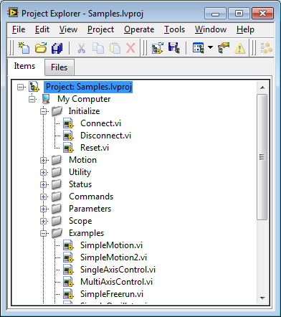
Samples Project
The Samples project file is installed to
[Installation Folder]\LabVIEW\2010\Samples.lvproj
Customers should avoid
saving changes to this
project.
The folders organize the
VIs by related functionality.

Slide 20
Samples Project Folders
Initialize
VIs to connect, disconnect, and reset the controller.
Connect.vi returns a controller handle that is required by most other VIs.
On the standalone, a connect also returns an array of all connected controllers.

Slide 21
Samples Project Folders
Motion
Configure motion: RampRate.vi, AnalogTrack.vi, Abs.vi, Inc.vi, etc.
Enable and Disable: Enable.vi, Disable.vi
Command motion: Home.vi, Linear.vi, Circular.vi, FreeRun.vi, etc.
Abort motion: Abort.vi
Acknowledge Faults: FaultAck.vi
Wait for motion to complete: Wait.vi

Slide 22
Samples Project Folders
Utility (miscellaneous helper VIs and CTLs)
Work with error codes: ParseError.vi, AlertError.vi
Use Axis Names and Indices: GetAxisIndex.vi, GetAxisName.vi, etc.
Get Version Information: GetVersion.vi
Access a reusable graphical interface similar to the Axis Manager in the Motion Composer suite: AxisControl.ctl
  This is a reusable graphical type definition. Examples > MultiAxisControl.vi shows how this CTL is used to provide a reusable graphical interface component.
  Unlike a VI, you do not run a .ctl

Slide 23
Samples Project Folders
Status
Get Controller Diagnostic Packets: RetrieveDiagPacket.vi, ConvertDiagPacket.vi
Get Custom Diagnostics: RetrieveCustomDiagPacket.vi
A3200 only starting in version 3.04
Directly retrieve task status items: GetTaskStatus.vi
A3200 only

Slide 24
Samples Project Folders
Commands
Acknowledge faults and task errors: AcknowledgeAll.vi
Immediate Commands: ExecuteCommand.vi
Program Control: ExecuteProgram.vi, StopProgram.vi
Set Outputs: SetAnalogOutput.vi, SetDigitialOutput.vi
Variables
  Standalone: ReadGlobal(s).vi, WriteGlobal(s).vi
  A3200: GetGlobalVariable(s).vi, SetGlobalVariable(s).vi, GetDoubleTaskVariable(s).vi, SetDoubleTaskVariable(s).vi

Slide 25
Samples Project Folders
Parameters
Get and set parameters: GetAxisParameter.vi, SetAxisParameter.vi, etc.
Set Active Parameter File: SendParameterFile.vi
A3200 only
Send/Commit: SendParameterFile.vi, CommitParameters.vi
Standalone only
Save parameter file: SaveParameterFile.vi

Slide 26
Samples Project Folders
Scope (Data Collection)
Typical order of operations: configure, collect, retrieve, extract
  A3200: AddDataConfiguration.vi, StartDataCollection.vi, RetrieveData.vi, GetDataResults.vi, etc.
  Standalone: TriggerScopeCollect.vi, GetScopeData.vi, AxisDataResults.ctl, ControllerDataResults.ctl
File (Standalone only)
Work with files on the controller file system: FileList.vi, FileSend.vi, FileRetrieve.vi, etc.

Slide 27
Samples Project Folders
Examples
These VIs are a good reference to see how to perform common controller operations by combining Aerotech sub-VIs.
You can directly run the VIs in this folder. They will connect to a controller and either perform a sequence of operations or allow the user to initiate some operation(s).

Slide 28
Debugging and Troubleshooting VIs
This document is a walk-through for debugging VIs.
This walk-through demonstrates:
  How to work with the Front Panel and the Block Diagram of a VI
  How to use the Tools Palette
  How to view LabVIEW’s Context Help window
  How to run a VI
  How to Highlight Execution, Set Breakpoints and use a Probe to monitor data.

Slide 29
Creating
Creating a project
Creating a VI
Building an application

Slide 30
Creating Your Own Project
National Instruments strongly recommends that VIs that use .NET objects be contained in a LabVIEW project and not be used as standalone VIs.
Copy the Bin folder that is installed by the controller software to the project location. LabVIEW searches for necessary .NET assemblies in the Bin and Data subdirectories of the project path.
When you upgrade the controller software, you must update the Bin folder in the project location.
Any exception from a .NET object can cause an 1172 error code, but mismatched assembly versions is the most common cause.

Slide 31
Creating Your Own Project (continued)
To copy the assemblies to the correct path:
Create a new LabVIEW project and save the project. Then you can use the controller VIs and not change the Samples.lvproj LabVIEW project that was installed with the controller software.
In [Installation Folder]\LabVIEW\2010\, find the Bin folder. Copy the Bin folder to the folder where you saved the new LabVIEW project.
Close LabVIEW. Then reopen LabVIEW and it will locate the copied assemblies.

Slide 32
Creating Your Own Project (continued)
Customers will generally want to include Aerotech VIs in their own project which can include VIs for other instruments.
Customers typically copy the VIs from the installation folder to their project. In this case, these VIs must also be updated if a different version of controller software is installed.

Slide 33
Creating Your Own Project (continued)
Customers should not make changes to the Samples project because:
  There could be inadvertent changes to the Aerotech sub-VIs.
  Administrative rights in Windows might be required to save changes to the project because of the required write permissions to the Program Files folder.

Slide 34
Creating Your Own VI
This document is a walk-through for creating a simple VI.
This walk-through demonstrates:
  How to work with the Front Panel and the Block Diagram of a VI
  How to use the Tools Palette
  How to view LabVIEW’s Context Help window
  How to wire VI inputs and outputs
  How to arrange controls on the Front Panel of a VI.

Slide 35
Building an Application
Customers often create an executable (.exe) from their LabVIEW project.
The output folder for the executable must contain the same Bin folder that was copied to the project folder.
Users can demo an Aerotech VI even if they do not have the LabVIEW development environment.
  Aerotech distributes an executable for the demo.
  To use the demo, you must have the LabVIEW 2010 runtime engine installed.
  [Installation Folder]\LabVIEW\2010\Bin\[Product] LabVIEW Operator Interface.exe

Slide 36
Questions?

