Slide 1
MATLAB
What You Need to Know

Slide 2
What You Will Learn About MATLAB
What is MATLAB
  Using it with the Motion Composer Suite
  Using it with Motion Designer
How to PROGRAM in MATLAB
What is the MATLAB LIBRARY
How to get STARTED
What you can DO with it

Slide 3
What is
MATLAB

Slide 4
What is MATLAB
A development environment designed for modeling and simulating systems
  Data processing and analysis
  Frequency and time domain
  Sampled systems vs continuous time analysis
A high-level programming language
  C-style, array-based language
  Easy matrix operations
  Many built-in functions for filtering, transforming and plotting data
Notes:
Can develop stand-alone executable.

Slide 5
What is MATLAB
Also includes Simulink as an optional package
  Graphical, time-based system simulation
  Aerotech does not support Simulink

Slide 6
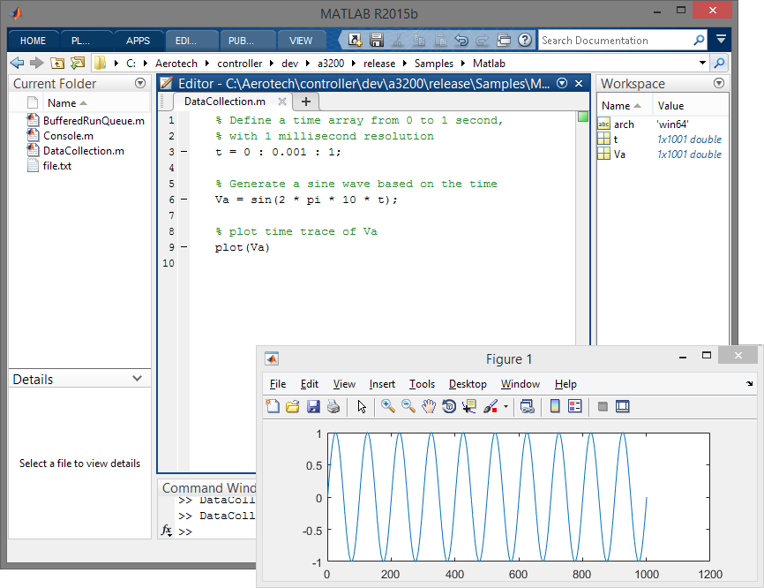
Image: MATLAB Interface

Slide 7
MATLAB and the Motion Composer Suite
Aerotech data collection applications can export data to MATLAB files (.mat)
  Digital Scope, Motion Designer, Motion Simulator
  These files can easily be loaded as MATLAB variables
Open these files in MATLAB for data analysis and post-processing
  Export a collected step response from Digital Scope
  Analyze data in MATLAB to understand the system
  Model the system in MATLAB and post-process the data to simulate system changes

Slide 8
MATLAB and the Motion Designer
Motion Designer can import MATLAB files (.mat) as trajectories
Use MATLAB tools to generate or perfect a trajectory
  Then use Motion Designer to command motion
  Also utilize Motion Designer features such as Iterative Learning Control
Create the overall trajectory in Motion Designer
Export it to MATLAB
Tweak it in MATLAB (i.e., filter it)
Import it back into Motion Designer
Notes:
For example, see steps 1-4.

Slide 9
How to
PROGRAM
in MATLAB?

Slide 10
Programming Basics
MATLAB does not have data types (integer, string, etc.)
All variables are double-precision floating point numbers
You do not need to declare a variable before you use it
Array indices are 1-based, not 0-based like other languages
Some functions throw errors, others return error codes
  All Aerotech functions will throw errors
Semicolon is used differently in MATLAB
  Primarily used to not display output for a line of code
  Not used to mark the end of a line or expression

Slide 11
Programming Basics
Mathworks publishes short and simple introductory videos online
  http://www.mathworks.com/products/matlab/videos.html
  http://www.mathworks.com/support/learn-with-matlab-tutorials.html

Slide 12
Creating Variables
% Create and assign a variable, no need to declare variables before using them % Use a semicolon to prevent assignment from showing up in Command Window myvar = 123; % Create an array (almost every function in MATLAB can natively operate % on arrays and matrices) myarray = [1 2 3 4 5]; % Create a vector from 1 to 10 in increments of 0.5 (0.0, 0.5, 1.0, 1.5, etc.) myarray2 = 1:0.5:10;

Slide 13
Control Structures
% For loop that goes from 1 to 10 for R = 1:10 myvar = myvar + R; end % While loop that continue to loop until condition is false while myvar > 0 myvar = myvar - 1; end % Conditional if statement with elseif and else blocks if myvar == 123 % ... elseif myvar == 246 % ... else % ... end

Slide 14
Importing and Exporting Data
% Load all variables from the binary .mat file (exported from Digital Scope) load('mydata.mat') % Load only the poscmd variable from the binary .mat file load('mydata.mat', 'poscmd') % Load only the variables starting with ‘pos’ (poscmd, posfbk, poserr) load('mydata.mat', 'pos*') % Save the variables poscmd and posfbk to a binary .mat file save('mydata.mat', 'poscmd', 'posfbk') % Save the variables poscmd and posfbk to a ASCII .txt file save('mydata.mat', 'poscmd', 'posfbk', '-ascii')

Slide 15
Image: MATLAB Interface

Slide 16
What is the MATLAB
LIBRARY
?

Slide 17
What is the MATLAB Library?
Our API for customers to write MATLAB programs that can interact with our controllers
Requires the MATLAB option in the license key
(A3200, Ensemble, and Soloist)
Supports MATLAB r2010b and newer (32- and 64-bit)
Built on the C Library and has most of the same features
  Motion
  (independent and coordinated)
  Data collection
  Programs
  Diagnostics and status
  Controller variables
  (globals, registers, task, program)
  I/O
  Parameters
Notes:
Must uninstall/reinstall to get the MATLAB library with new key.
Doesn’t support everything (system configuration and callbacks).

Slide 18
Why use the MATLAB Library?
Customers most familiar with MATLAB will like to work exclusively in MATLAB
Utilize the powerful data analysis features of MATLAB
  These features help you understand the dynamics of your system

Slide 19

Why use the MATLAB Library?
You can command motion, collect data, and analyze the data all in MATLAB
  You do not have to use AeroBasic and/or Digital Scope to collect data just to export it to MATLAB
  This is the main use-case for customers
MATLAB is slower than other interfaces (C or .NET)
Not a problem for the main use-case
Customers probably shouldn’t use MATLAB to run their main process

Slide 20
Getting
STARTED
with the MATLAB Library

Slide 21
Getting Started with the MATLAB Library
% Add the controller Matlab library to the path arch = computer('arch'); if(strcmp(arch, 'win32')) addpath('..\..\Matlab\x86') elseif(strcmp(arch, 'win64')) addpath('..\..\Matlab\x64') end
Every MATLAB program that uses our library must have this code
The code tells MATLAB where to find our library and what version to use (32- or 64-bit)
This is the only step required by users to get started

Slide 22

Getting Started with the MATLAB Library
% Add the controller Matlab library to the path arch = computer('arch'); if(strcmp(arch, 'win32')) addpath('..\..\Matlab\x86') elseif(strcmp(arch, 'win64')) addpath('..\..\Matlab\x64') end
Common Problem #1
addpath must point to the correct directory.
If done incorrectly, MATLAB might behave strangely or crash unexpectedly.
The example path is the relative path from the Samples directory to the Matlab directory. When customers write their own MATLAB programs, the path will be different.

Slide 23
Documentation and Samples
MATLAB Library Help is in the Programming help file
Useful topics
  MATLAB Interface > Modules
  Blocking Behavior of the Libraries
  64-bit Support
MATLAB samples are installed in
C:\Program Files\Aerotech\A3200\Samples\Matlab
  Use as a starting point for your own programs
  Most of this content came from these samples
Notes:
Open up Programming Help (MATLAB).

Slide 24
What Can You
DO
with it?

Slide 25
Example MATLAB Code
% Connect to a controller handle = A3200Connect; % Create a data collection configuration dataCollHandle = A3200DataCollectionConfigCreate(handle); % Add some signals to collect A3200DataCollectionConfigAddSignal(dataCollHandle, A3200DataSignal.PositionFeedback, 0, 0) A3200DataCollectionConfigAddSignal(dataCollHandle, A3200DataSignal.VelocityFeedback, 0, 0) % Set collection rate and number of points A3200DataCollectionConfigSetPeriod(dataCollHandle, 1) A3200DataCollectionConfigSetSamples(dataCollHandle, 1000) % Start data collection using the configuration we just created A3200DataCollectionStart(handle, dataCollHandle) % Retrieve the data into MATLAB matrix (blocks until collection completes) collectedData = A3200DataCollectionDataRetrieve(handle, dataCollHandle, 1000); % Finally make sure to clean up any memory we created A3200DataCollectionConfigFree(dataCollHandle); A3200Disconnect(handle)
Notes:
Assumes addpath is already done.

Slide 26
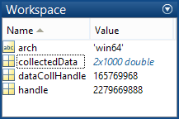
Example MATLAB Code
collectedData variable is a 2x1000 matrix
  The 2 rows represent PosFbk and VelFbk
  The 1000 columns are the 1000 points we collected
Notes:
Open up Programming Help (MATLAB).

Slide 27
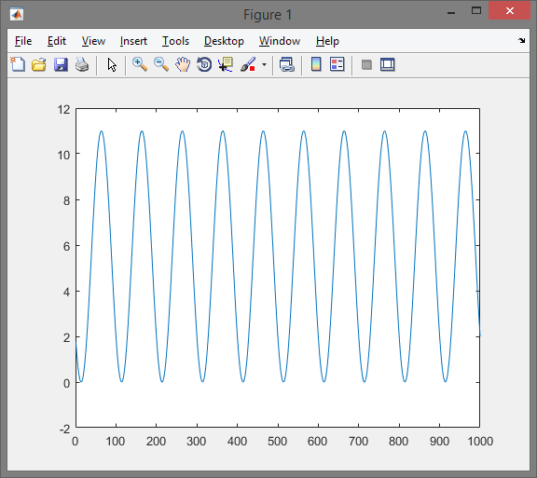
Example MATLAB Code
% Plot position feedback (the 1st row in the collectedData matrix) plot(collectedData(1,1:1000))
(1,1:1000) tells MATLAB to grab columns 1-1000 of the first row
Notes:
Controller was doing an OSCILLATE command while collecting data.

Slide 28
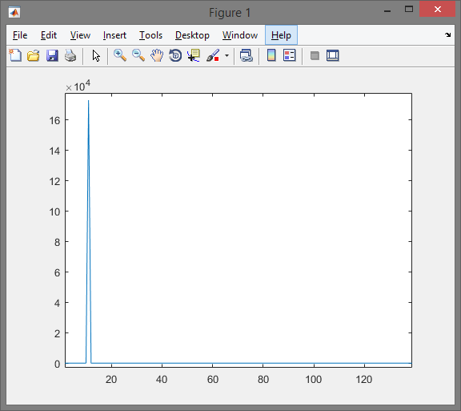
Example MATLAB Code
% Compute and plot the FFT of velocity feedback velfft = abs(fft(collectedData(2,1:1000))); plot(velfft)
The fft function computes frequency domain data

Slide 29
Example MATLAB Code
% Create a data collection configuration dataCollHandle = A3200DataCollectionConfigCreate(handle); ... % Finally make sure to clean up any memory we created (the data collection config) A3200DataCollectionConfigFree(dataCollHandle);
Common Problem #2
All handles that are created must be cleaned (freed).
If done incorrectly, MATLAB will leak memory.
The most common handles that needs to be cleaned (freed) are handles to data collection configurations.
Be sure to disconnect from the controller.

Slide 30
Other Things You Can Do
% We want to operate on axes X and Y everywhere axes = [0, 1]; % Enable and home both X and Y A3200MotionEnable(handle, 1, axes) A3200MotionHome(handle, 1, axes) % Move X and Y to positions 5 and 10, respectively, using Task 1 A3200MotionLinearVelocity(handle, 1, axes, [5, 10], 5) % Move X (axis 0) to position 10 with speed 15, using Task 1 A3200MotionMoveAbs(handle, 1, 0, 10, 15) % Get status back from Y (axis 1) myposfbk = A3200StatusGetItem(handle, 1, A3200StatusItem.PositionFeedback, 0); % Set global and task variables A3200VariableSetGlobalDouble(handle, 0, 123) mytaskdouble = A3200VariableGetTaskDouble(handle, 2, 9); % Change Kpos parameter on the controller for X (axis 0), set to 50 A3200ParameterSetValue(handle, A3200ParameterId.GainKpos, 0, 50)
Notes:
Assumes addpath is already done.

Slide 31
Questions

